Slide 1



Financing New Venture

Slide 2
What will
we talk about?
Equity financing Venture Capital,
Debt Financing and Govt. Grants.
Functions and objectives of Specialised Financial institutions.

Slide 3

The Importance of Getting
Financing or Funding

Slide 4
The Importance of Getting
Financing or Funding
  The Nature of the Funding and Financing Process ?
  Few people deal with the process of raising investment capital until they need to raise capital for their own firm.
  As a result, many entrepreneurs go about the task of raising capital haphazardly because they lack experience in this area.
  Why Most New Ventures Need Funding ?
  There are three reasons most new ventures need to raise money during their early life.
  The three reasons are shown on the following slide.

Slide 5
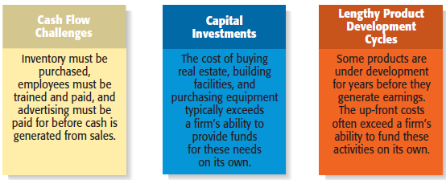
3 Reasons Why Most New Ventures Need Funding

Slide 6

Alternatives for Raising Money for a
New Venture or Methods Of Financing
Personal Funds
Equity Capital
Debt Financing
Creative Sources

Slide 7
Sources of Personal Financing…
Personal Funds
  The vast majority of founders contribute personal funds, along with sweat equity, to their ventures.
    Sweat equity represents the value of the time and effort that a founder puts into a new venture.
Friends and Family
  Friends and family are the second source of funds for many new ventures.

Slide 8

……Sources of Personal Financing.
Bootstrapping
  A third source of seed money for a new venture is referred to as bootstrapping.
  Bootstrapping is finding ways to avoid the need for external financing or funding through creativity, ingenuity, thriftiness, cost cutting, or any means necessary.
  Many entrepreneurs bootstrap out of necessity.

Slide 9
Examples of Bootstrapping Methods
Buy used instead of
new equipment.
Coordinate purchases
with other businesses.
Lease equipment
instead of buying.
Obtain payments in
advance from
customers.
Minimize personal
expenses.
Avoid unnecessary
expenses.
Buy items cheaply but
prudently via options
such as eBay.
Share office space or
employees with other
businesses.
Hire interns.

Slide 10
Methods Of Financing….
Debt
Financing
Equity
Capital

Slide 11


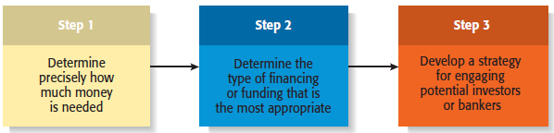
Preparing to Raise Debt or Equity Financing

Slide 12
Preparing to Raise Debt or Equity Financing
Two Most Common Alternatives
Equity Funding
Debt Financing
Means exchanging partial ownership in a firm, usually in the form of stock, for funding.
Is getting a loan.

Slide 13
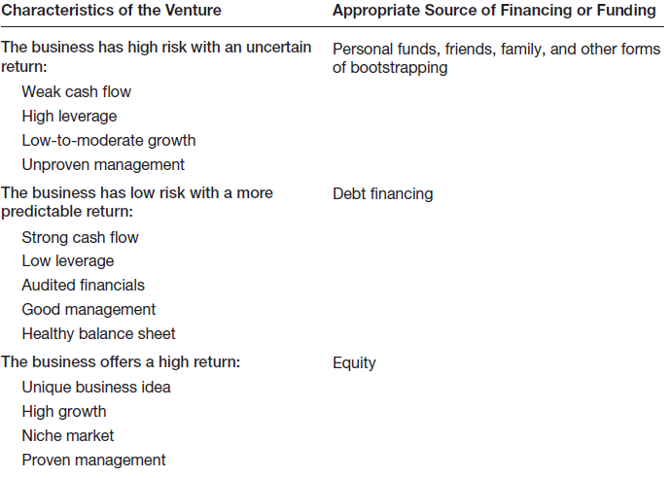
Preparing to Raise Debt or Equity Financing
Matching a New Venture’s Characteristics with the Appropriate Form of Financing or Funding

Slide 14
Sources of Equity Funding
Venture Capital
Business Angels
Initial Public Offerings

Slide 15
BUSINESS ANGELS…..
Business Angels
  Are individuals who invest their personal capital directly in start-ups.
  The prototypical business angel is about 50 years old, has high income and wealth, is well educated, has succeeded as an entrepreneur, and is interested in the start-up process.
  Business angels are valuable because of their willingness to make relatively small investments.

Slide 16
…..BUSINESS ANGELS
  Most angel investors are successful entrepreneurs and retired executives that want to get involved in helping small start-ups succeed by offering private financing and sometimes, valuable expertise & experience as well.
  They are well educated and often in their 40’s or 50’s and look for investments across a broad range of businesses that offer high growth potential.
  Business angels are difficult to find.

Slide 17
Venture Capital…..
Venture Capital
  Is money that is invested by venture capital firms in start-ups and small businesses with exceptional growth potential.
  Venture capital can be broadly regarded as a pool of equity capital that come from different individuals or groups of individuals who want to invest in high growth businesses for high returns
  Unlike angel investors that invest their own funds, venture capitalists are professional managers investing money from a pool of funds (equity capital pool) parked under registered venture capital companies.
  While venture capital funds are found in a diverse range of business sectors they do tend to focus on high potential, innovation & technology-centered businesses such as ICT development business and biotechnology companies.
  Venture capital prefer to invest at early stage to full growth & expansion stage of business growth
  The amount of capital available for investment can start at RM 1 million for early growth financing and extend to RM20 million at later stages of growth financing

Slide 18
….Venture Capital…..
Venture Capital
  Venture capital firms fund very few entrepreneurial firms in comparison to business angels.
    Many entrepreneurs get discouraged when they are repeatedly rejected for venture capital funding, even though they may have an excellent business plan.
    Venture capitalists are looking for the “home run” and so reject the majority of the proposals they consider.
  - An important part of obtaining venture capital funding is going through the due diligence process.
  - Venture capitalists invest money in start-ups in “stages,” meaning that not all the money that is invested is disbursed at the same time.
  - Some venture capitalists also specialize in certain “stages” of funding.

Slide 19
Initial Public Offering
Initial Public Offering
  An initial public offering (IPO) is a company’s first sale of stock to the public. When a company goes public, its stock is traded on one of the major stock exchanges.
  Most entrepreneurial firms that go public trade on the NASDAQ, which is weighted heavily toward technology, biotech, and small-company stocks.
  An IPO is an important milestone for a firm. Typically, a firm is not able to go public until it has demonstrated that it is viable and has a bright future.

Slide 20
Initial Public Offering
Reasons that Motivate Firms to Go Public
Is a way to raise equity capital to fund current and future operations.
Raises a firm’s public profile, making it easier to attract high-quality customers and business partners.

Slide 21
Initial Public Offering
Reasons that Motivate Firms to Go Public
Is a liquidity event that provides a means for a company’s investors to recoup their investments.
Creates a form of currency that can be used to grow the company via acquisitions.

Slide 22
Sources of Debt Financing
SBA Guaranteed Loans
Commercial Banks

Slide 23
Sources of Debt Financing
Banks
  Historically, commercial banks have not been viewed as a practical source of financing for start-up firms.
  This sentiment is not a knock against banks; it is just that banks are risk averse, and financing start-ups is a risky business.
    Banks are interested in firms that have a strong cash flow, low leverage, audited financials, good management, and a healthy balance sheet.

Slide 24
Sources of Debt Financing
Vendor Credit
  Also known as trade credit, is when a vendor extends credit to a business in order to allow the business to buy its products and/or services up front but defer payment until later.
Factoring
  Is a financial transaction whereby a business sells its accounts receivable to a third party, called a factor, at a discount in exchange for cash.

Slide 25
Sources of Debt Financing
Peer-to-Peer Lending
  Is a financial transaction that occurs directly between individuals or peers.
  The loans are facilitated by online firms such as Funding Circle, Lending Club, and Dealstruck.
  Be sure to watch out for high interest rates, usually between 12 percent to 24 percent.

Slide 26
Creative Sources of Financing or Funding
Crowdfunding
Leasing
SBIR and STTR Programs
Other Grant Programs
Strategic Partners

Slide 27
Creative Sources of Financing or Funding
Crowdfunding
  Crowdfunding is the practice of funding a project or new venture by raising monetary contributions from a large number of people (the “crowd”) typically via the Internet.
Two Types of Crowdfunding Programs
  Rewards-based crowdfunding allows entrepreneurs to raise money in exchange for some type of amenity or reward.
  The most popular rewards-based crowdfunding sites are Kickstarter, Indiegogo, and RocketHub.

Slide 28
Creative Sources of Financing or Funding
Two Types of Crowdfunding Programs (continued)
  Equity-based crowdfunding helps businesses raise money by tapping individuals who provide funding in exchange for equity in the business.
  It appears that equity-based crowdfunding will be confined to entrepreneurs raising money from accredited investors.
  Equity-based crowdfunding sites include FundersClub, Crowdfunder.com, and Circle Up.

Slide 29
Leasing
Leasing
  A lease is a written agreement in which the owner of a piece of property allows an individual or business to use the property for a specified period of time in exchange for payments.
  The major advantage of leasing is that it enables a company to acquire the use of assets with very little or no down payment.
Thank you!

Slide 30
Leasing
Leasing (continued)
  Most leases involve a modest down payment and monthly payments during the duration of the lease.
  At the end of an equipment lease, the new venture typically has the option to stop using the equipment, purchase it for fair market value, or renew the lease.
  Leasing is almost always more expensive than paying cash for an item, so most entrepreneurs think of leasing as an alternative to equity or debt financing.
Thank you!

Slide 31
Government Grants and schemes
Thank you!
https://www.startupindia.gov.in/content/sih/en/government-schemes.html
https://www.startupindia.gov.in/#funding-section

Slide 32
Strategic Partners
Strategic Partners
  Strategic partners are another source of capital for new ventures.
  Many partnerships are formed to share the costs of product or service development, to gain access to particular resources, or to facilitate speed to market.
  Older established firms benefit by partnering with young entrepreneurial firms by gaining access to their creative ideas and entrepreneurial spirit.
Thank you!

Slide 33
Strategic Partners
Biotech firms often partner
with large drug companies
to conduct clinical trials and
bring new products to
market.
The biotech firms benefit by
obtaining funding from their
partners, and the partners
benefit by having additional
products to sell.
Thank you!

Slide 34
Write
a successful
story.
All The Best
Thank you!

